Slide 1
Kernel Space Keylogger
Operating System Project
Group Members:
Harikrishnan KR
Jerin Jose
Govind S

Slide 2
Keylogger
A keylogger sometimes called a keystroke logger or a system monitor is a type of surveillance technology used to monitor and record each keystroke typed on a specific computer’s keyboard
We have written a linux kernel module to grab keys pressed in the keyboard.The key press logs are logged into debugfs.The logged keys can be seen in english format,hex format or as pure keycode(by using a module parameter)

Slide 3
Keylogger
The keylogger logs all keys pressed that have scancodes in the range 0-119. These are correspondingly mapped to their respective values and printed onto the debugfs.
First when a key is pressed on the keyboard the keyboard will send corresponding scancodes to keyboard driver.The handle_scancode() function in the keyboard driver parses the stream of scancodes and converts it into a series of key press and key release events called keycode by using a translation-table via kbd_translate() function. Each key is provided with a unique key code k in range 0-127. Pressing key k produces keycode k,while releasing it produces key code k+128.
We have considered the shift modifier to check whether the “shift” was pressed along with a key and hence map accordingly.

Slide 4
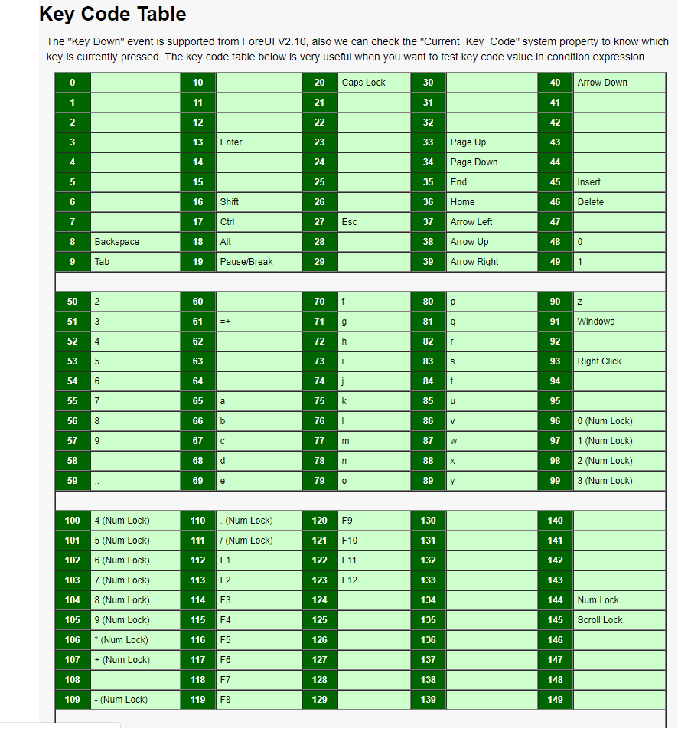

Slide 5
How it works?
Our program runs by registering a notifier_block with the keyboard using register_keyboard_notifier().This notifier_block’s .notifier_call is set to the keylogger_callback() function that receives the keycode value along with other params and converts it to the required form and then log it to the debugfs directory in a “keys” file.Only root or sudoers can read this log.
The register_keyboard_notifier() function is defined in /drivers/tty/vt/keyboard.c and takes a notifier_block as an argument.

Slide 6
keylogger_callback() function
The keylogger callback function initialises the buffer to hold the converted keycode and receives the params from the keyboard driver.
It then calls the function keycode_to_string() that convert the received keycode to required format using a hashmap and returns it.The converted keycode is then written into a buffer which is logged to the “keys” in debugfs.
The log will be cleared once the user logs out but a simple script can be written to copy its contents to another file.

Slide 7
References
Books:
https://www.tldp.org/LDP/lkmpg/2.4/lkmpg.pdf
Links:
https://github.com/vanhauser-thc/THC-Archive/blob/master/Papers/writing-linux-kernel-keylogger.txt
https://github.com/arunpn123/keylogger

Slide 8
THANK YOU

